Slide 1
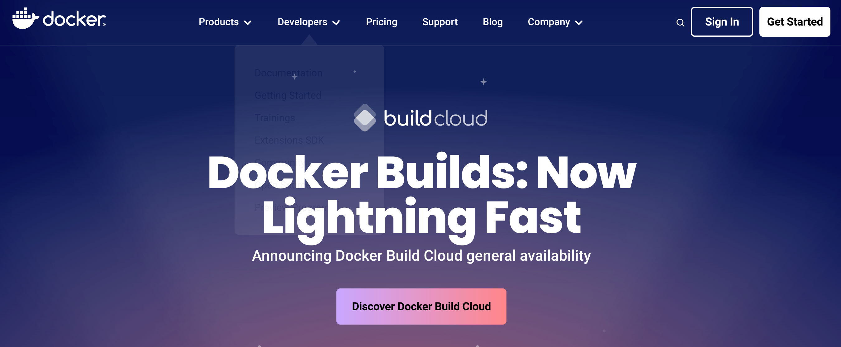
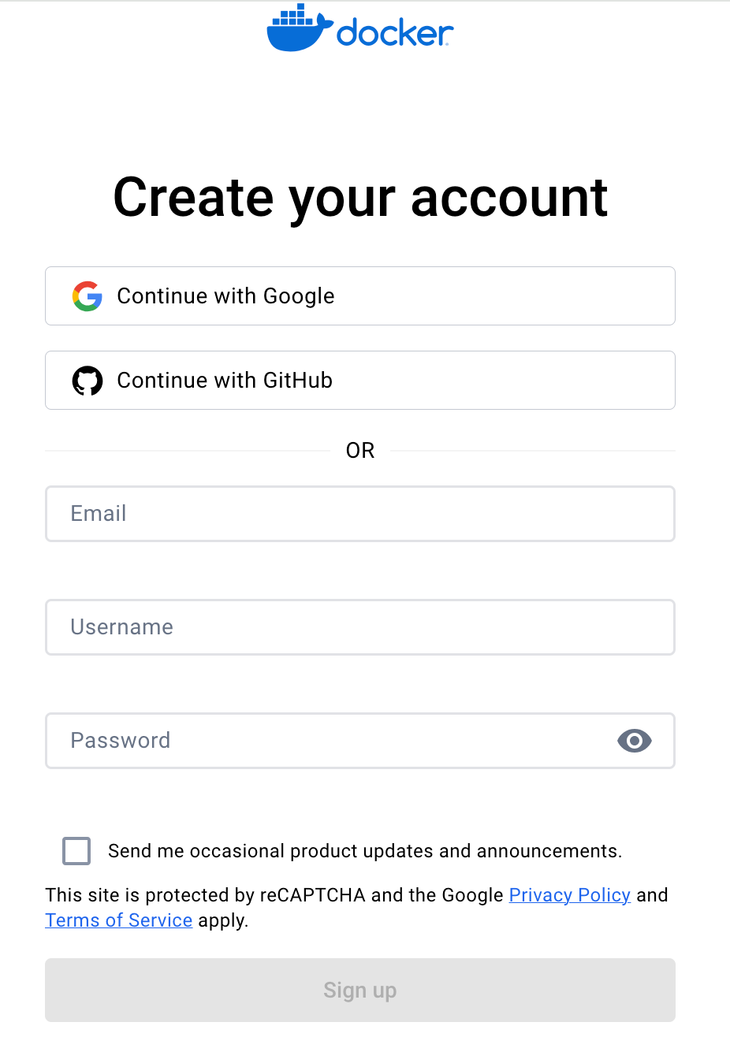
Create and activate a docker Account
❖
Docker home page at https://www.docker.com.
❖
On the Create an docker account page https://hub.docker.com/signup, enter your HKU email address (educators/ teaching staff: UID@hku.hk; students: UID@connect.hku.hk), password (a new password at your choice for login to docker) and account name (please put in your Portal UID unless it has been taken up by others), and then click Sign up.

Slide 2
Docker for Linux: Setting Up
❖
Introduction
This tutorial is designed to help students to leverage Docker, a powerful platform for developing, shipping, and running applications. Docker simplifies the management of application processes in containers, which are isolated from each other and the host system. A container is a lightweight, stand-alone, executable package that includes everything needed to run a piece of software, including the code, runtime, libraries, and system settings.
Before diving into the setup of MongoDB and Node-RED, let's cover the basics of creating a Docker container.
This guidance is applicable only to Ubuntu and macOS; adjustments may be necessary for Windows. Additionally, if using a virtual machine for MongoDB, the CPU may need to support hardware virtualization.

Slide 3
Creating Your Docker Container
❖
Installation of Docker
Execute the following commands sequentially:
Download the Docker installation script:
2. Run the installation script:
bash
curl -fsSL https://test.docker.com -o test-docker.sh
bash
sudo sh test-docker.sh

Slide 4
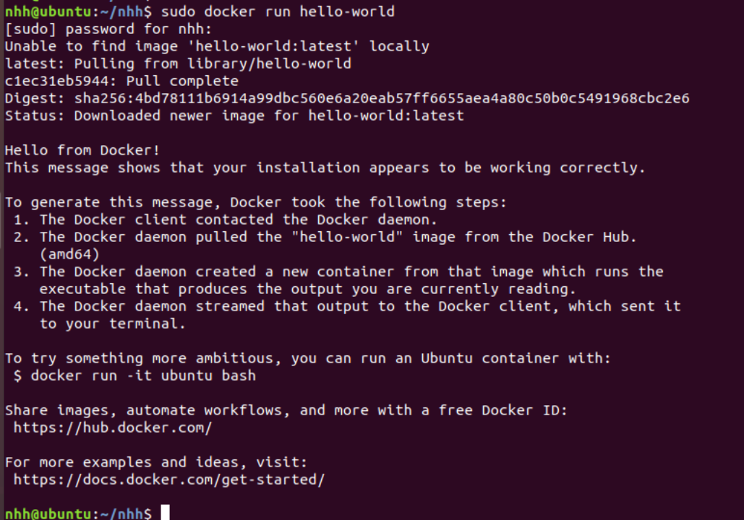
Creating Your Docker Container
❖
To test if Docker has been installed successfully, enter the command:
If you see a message similar to the one depicted below, Docker has been successfully installed.
sudo docker run hello-world

Slide 5
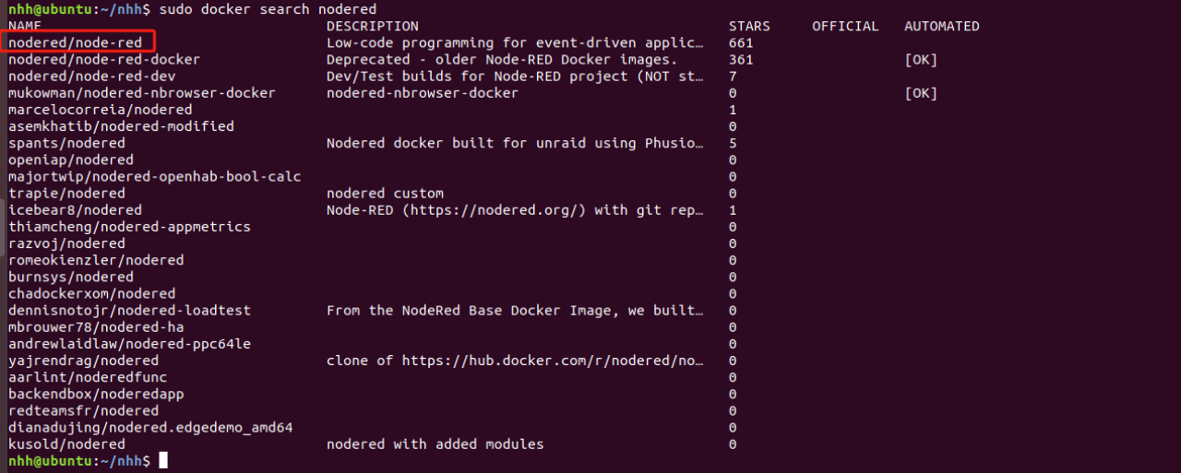
Install Node-RED Using Docker
❖
Searching for the Node-RED Image Version:
To find the version of the Node-RED image you want to install, enter the command:
sudo docker search nodered
From the results, we select nodered/node-red.

Slide 6
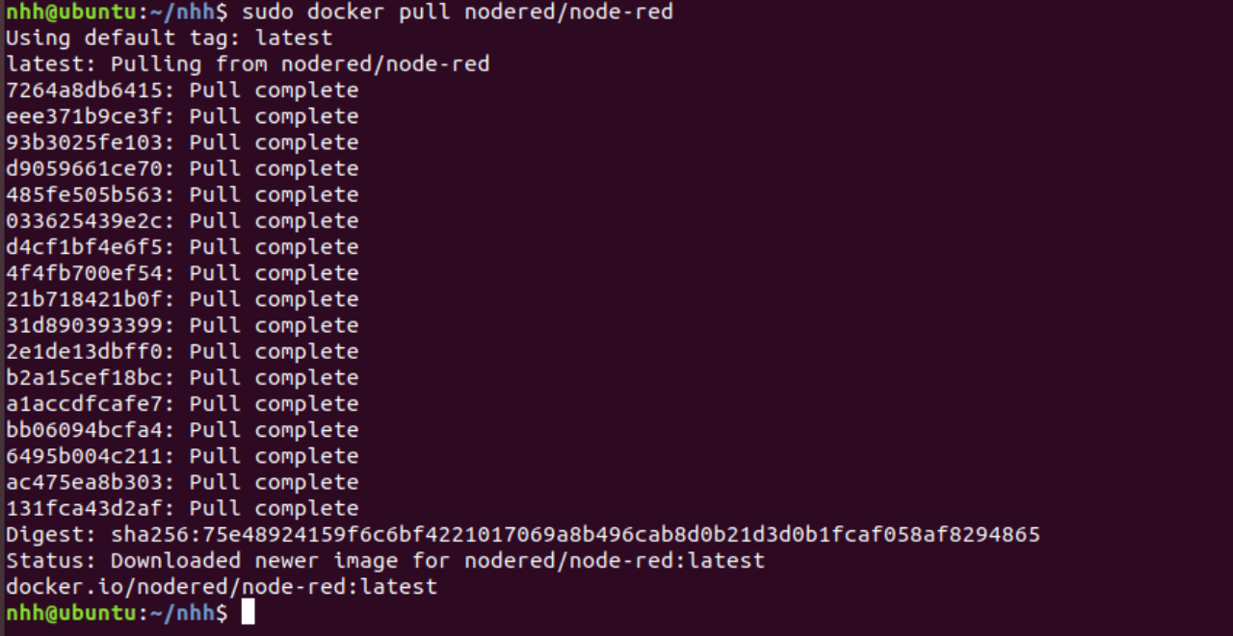
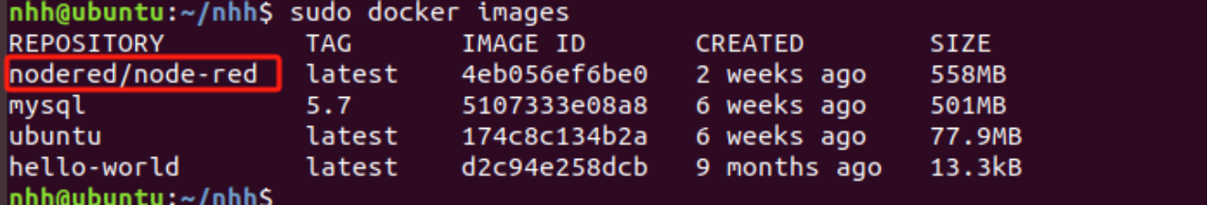
Install Node-RED Using Docker
❖
2. Pulling the Image
To pull the image, enter the command: sudo docker pull nodered/node-red
After executing sudo docker images, nodered/node-red has been successfully pulled.

Slide 7
Install Node-RED Using Docker
❖
3. Running the Node-RED Image as a Container
Create a Directory: Execute sudo mkdir /opt/node_red
Assign Permissions: Execute sudo chmod 777 /opt/node_red
Run the Image: sudo docker run -itd -p 1880:1880 -v /opt/node_red:/data --name nodered nodered/node-red
-v /opt/node_red:/data mounts the host's /opt/node_red directory to /data in the container.
--name nodered sets the container's name to nodered. You can see the running container named nodered by executing sudo docker ps -a.

Slide 8
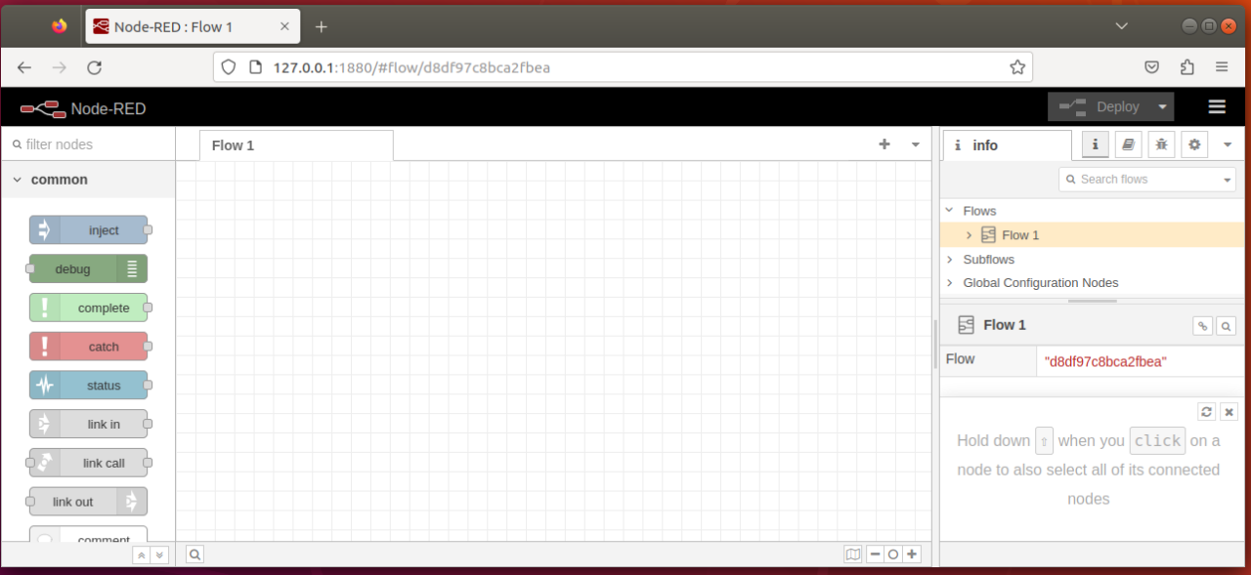
Install Node-RED Using Docker
Verifying the Container:
Open Google Chrome or any web browser and enter http://127.0.0.1:1880. If you see the Node-RED interface as expected, the container is running correctly.

Slide 9
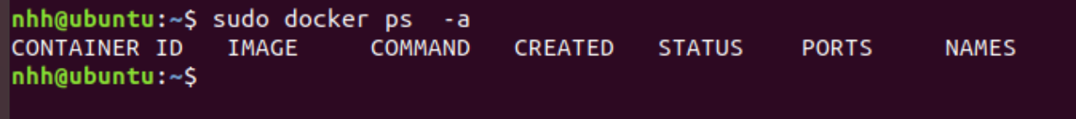
Install Node-RED Using Docker
❖
4. Deleting the Container
Get the Container ID: Enter sudo docker ps -a. Let's say the container ID is eaba53fa9c03.
Stop the Container: Execute sudo docker stop eaba53fa9c03. After this, if you run sudo docker ps -a, you should see the container's status as Exited.
Delete the Container: Execute sudo docker rm -f eaba53fa9c03. Afterward, running sudo docker ps -a will show that the container no longer exists.

Slide 10
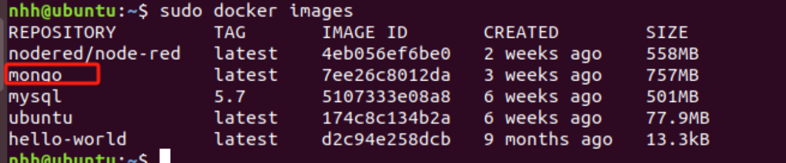
Install mongodb Using Docker
❖
1. Pulling the Image
To download the latest MongoDB image, enter the command: sudo docker pull mongo:latest
After executing sudo docker images, you will see that the MongoDB image has been successfully pulled.

Slide 11
Install mongodb Using Docker
❖
2. Running the MongoDB Image as a Container and Verification
Create a Directory: Execute sudo mkdir /opt/mongodb.
Assign Permissions: Execute sudo chmod 777 /opt/mongodb.
Run the Image: sudo docker run -itd -p 27017:27017 -v /opt/mongodb:/data/db --name Mymongo mongo:latest
-v /opt/mongodb:/data/db mounts the host's /opt/mongodb directory to /data/db in the container.
--name Mymongo sets the container's name to Mymongo. You can see the running container named Mymongo by executing sudo docker ps -a.

Slide 12
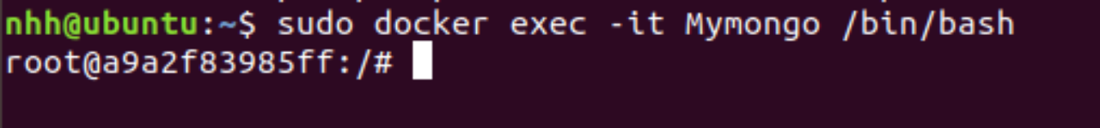
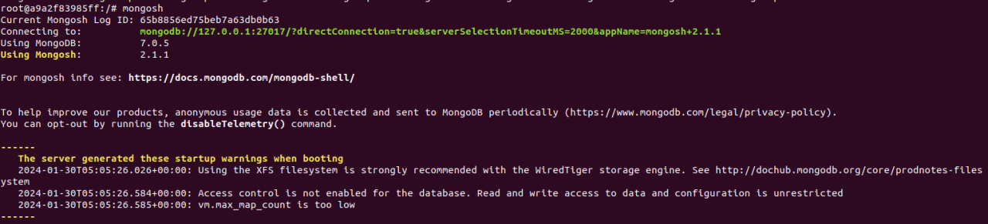
Install mongodb Using Docker
Entering the Container
To enter the container, use the command: sudo docker exec -it Mymongo /bin/bash
Then, start the MongoDB shell by entering mongosh.

Slide 13
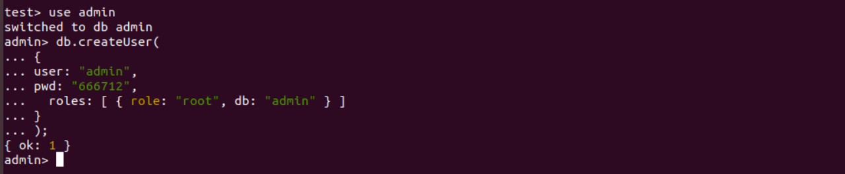
Install mongodb Using Docker
Create an admin user with the following commands:
use admin
db.createUser(
{
user: "admin",
pwd: " 666712",
roles: [ { role: "root", db: "admin" } ]
}
);

Slide 14
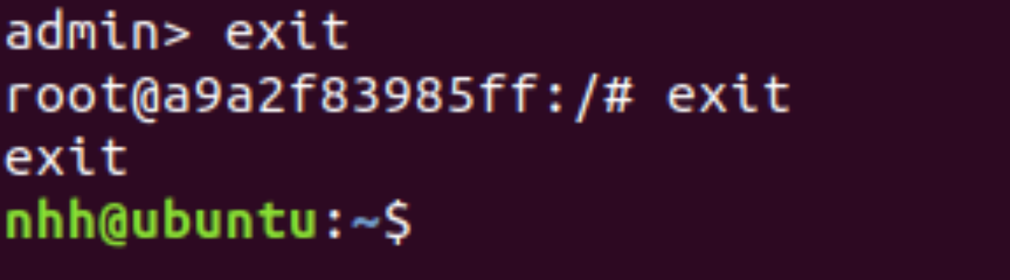
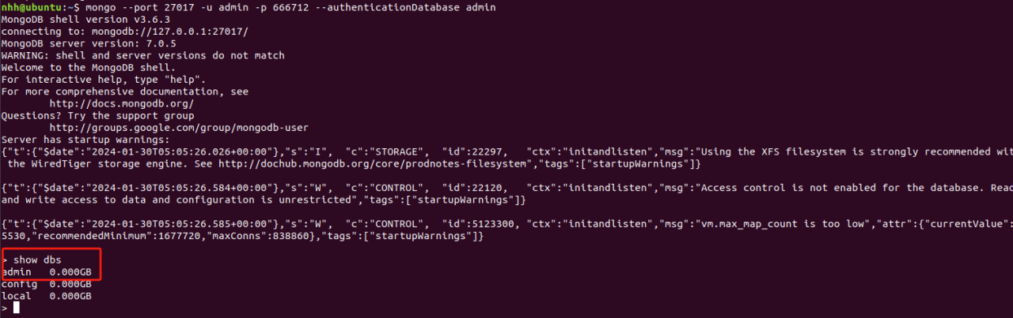
Install mongodb Using Docker
To exit the MongoDB shell, type exit, then type exit again to leave the container.
❖
To connect to MongoDB within the container, use: mongo --port 27017 -u admin - 666712 --authenticationDatabase admin. After connecting, entering show dbs will display the databases, including the admin database you created.
❖

Slide 15
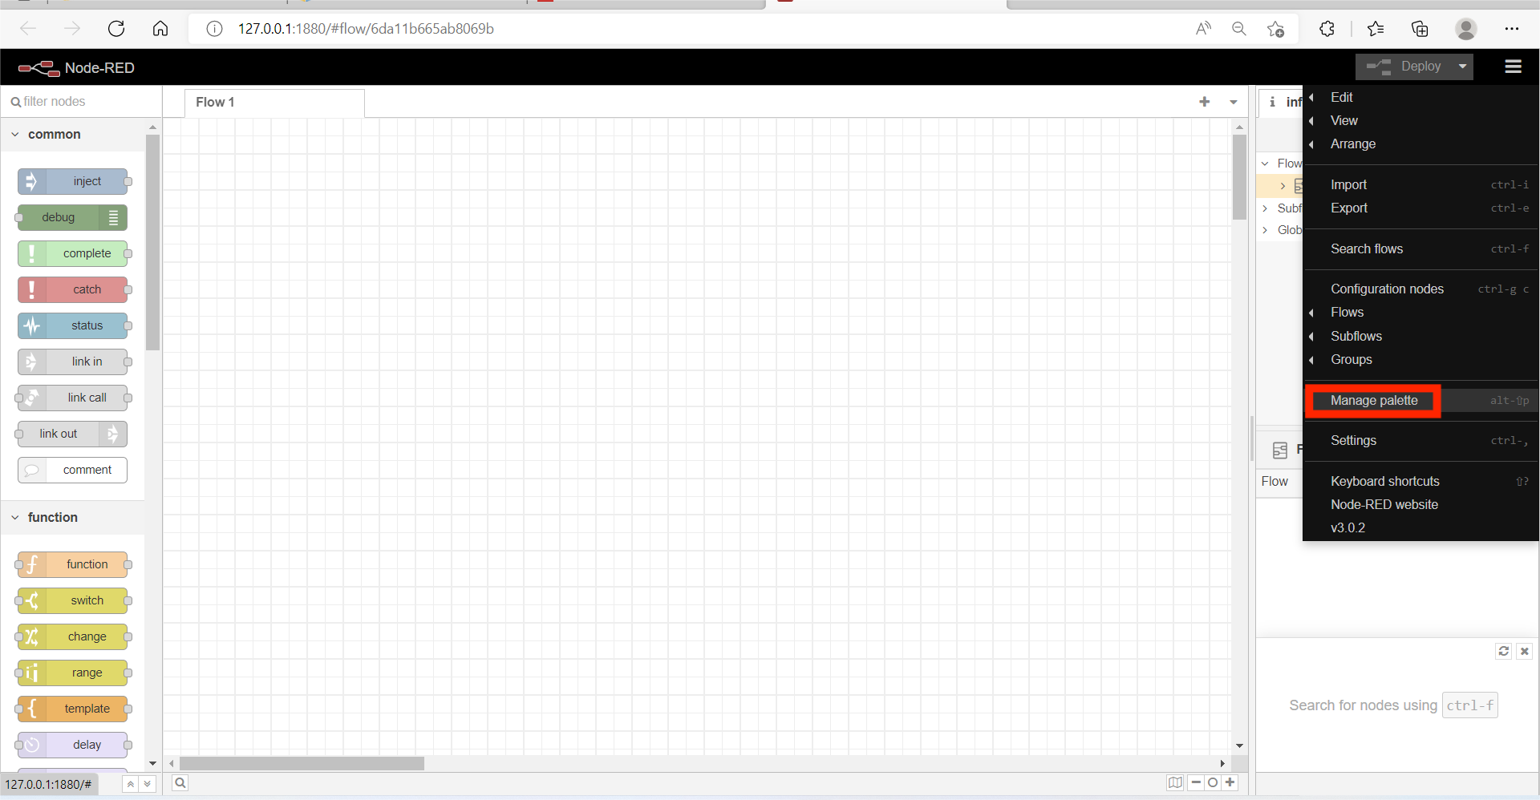
Installing MongoDB and Dashboard Modules in NodeRed
❖
Use a browser to access the URL: http://localhost:1880
Click the top right icon, select and click Manage Palette
❖

Slide 16
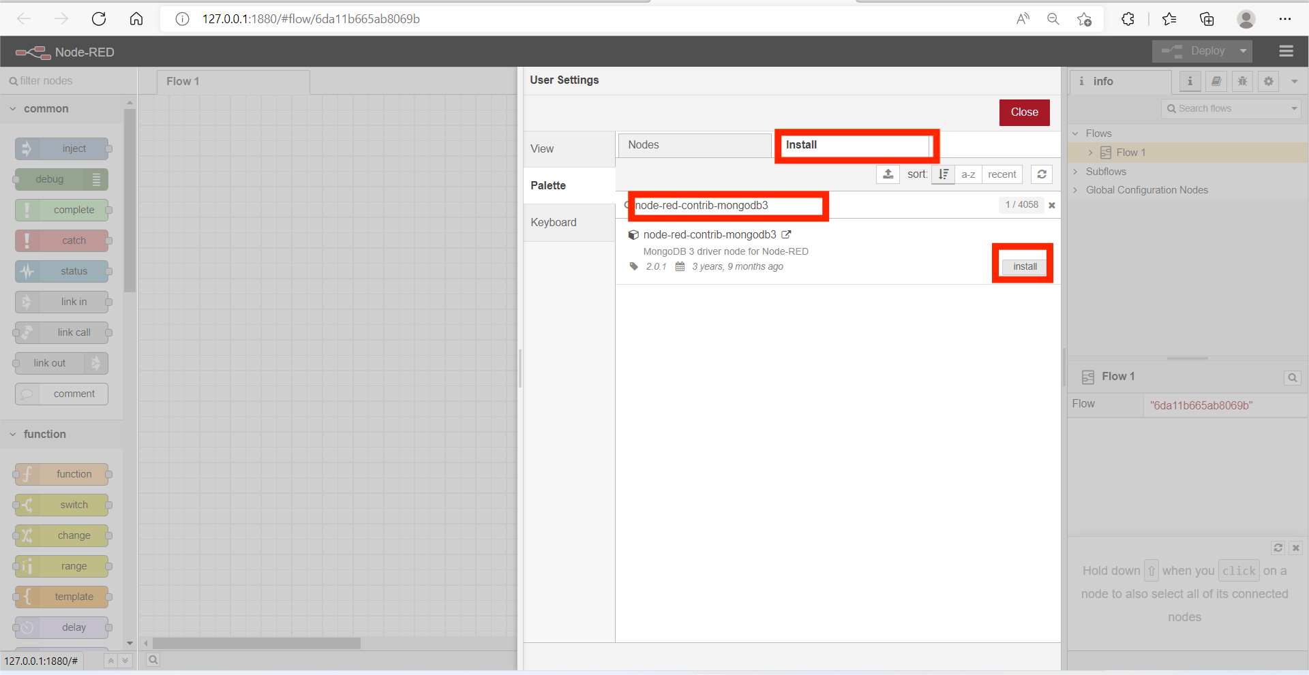
Installing MongoDB and Dashboard Modules in NodeRed
❖
Select the Install Tab, and input MongoDB in the search field.
Scroll down and locate the row with node-red-contrib-mongodb3, and click Install button, and click Install button again in the pop-up window.
❖

Slide 17
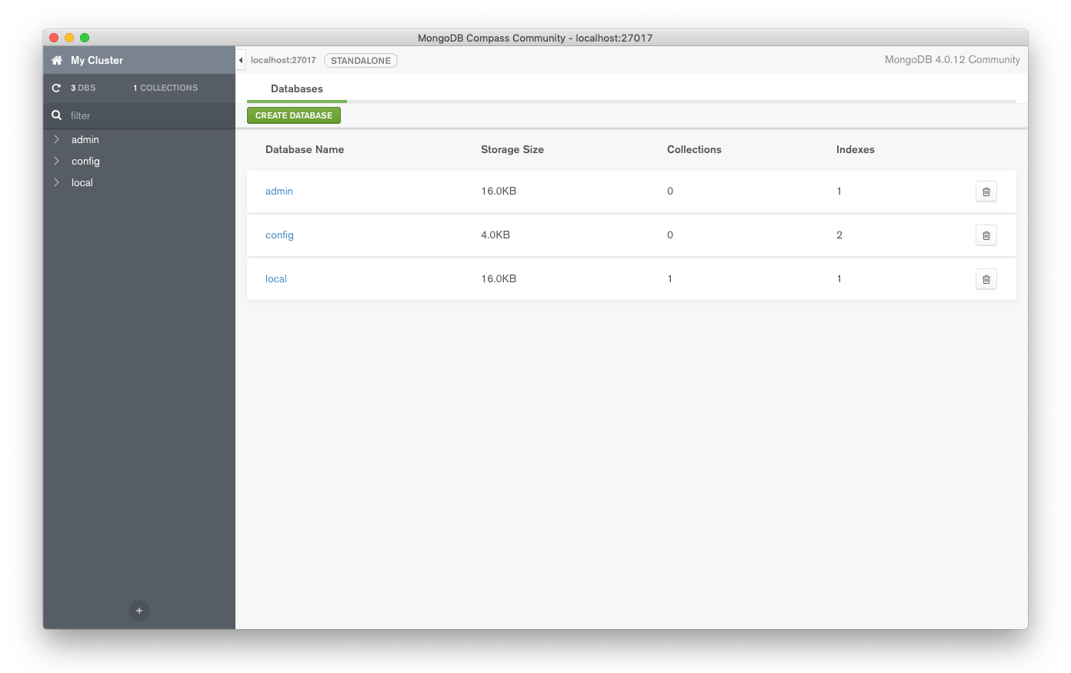
Accessing MongoDB
❖
Once connected, you should be able to browse your data stored in your MongoDB instance.

Slide 18
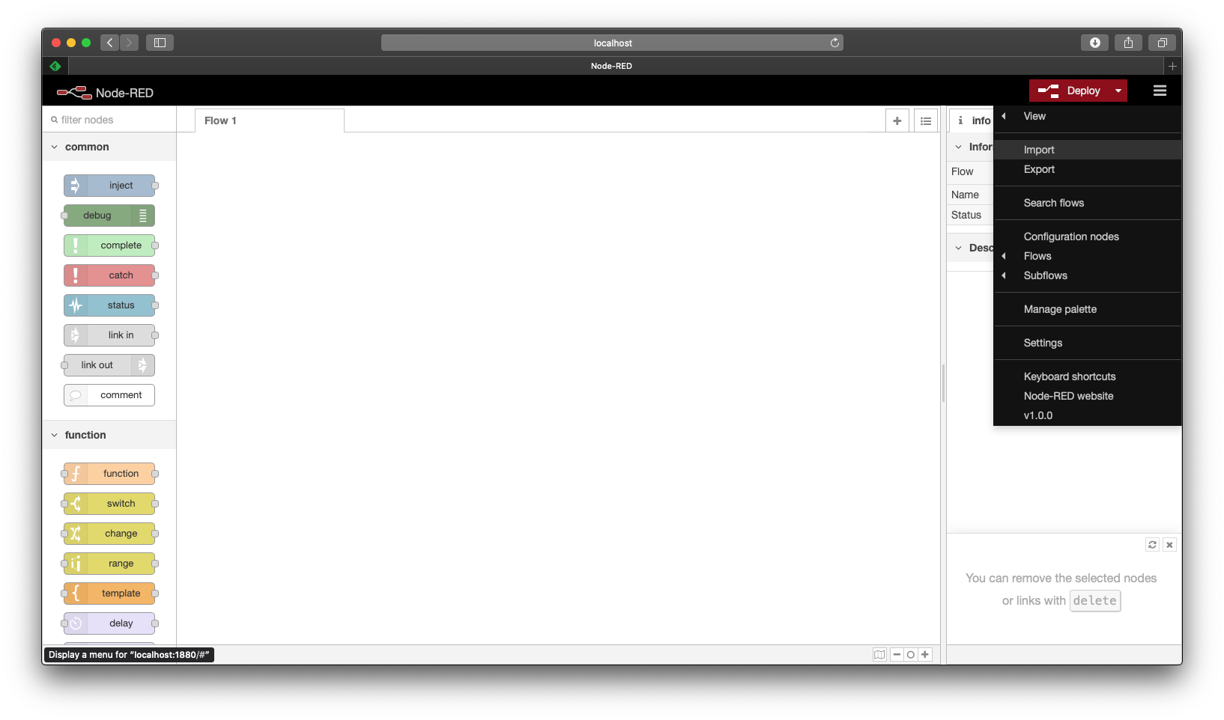
Node-Red Example Program
❖
Download the the HKO.Flow.txt file from moodle, and import it into your NodeRed environment:
1
2

Slide 19
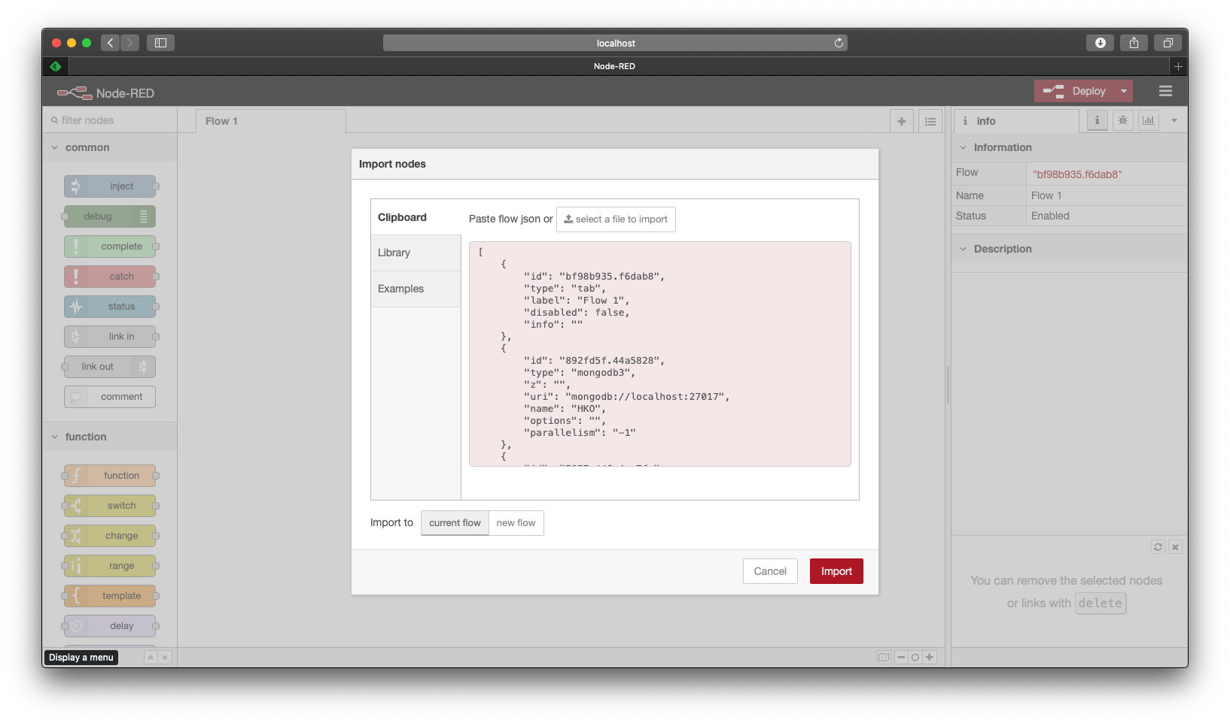
Node-Red Example Program
❖
Download the the HKO.Flow.json file from moodle, and import it into your NodeRed environment:
1
2

Slide 20
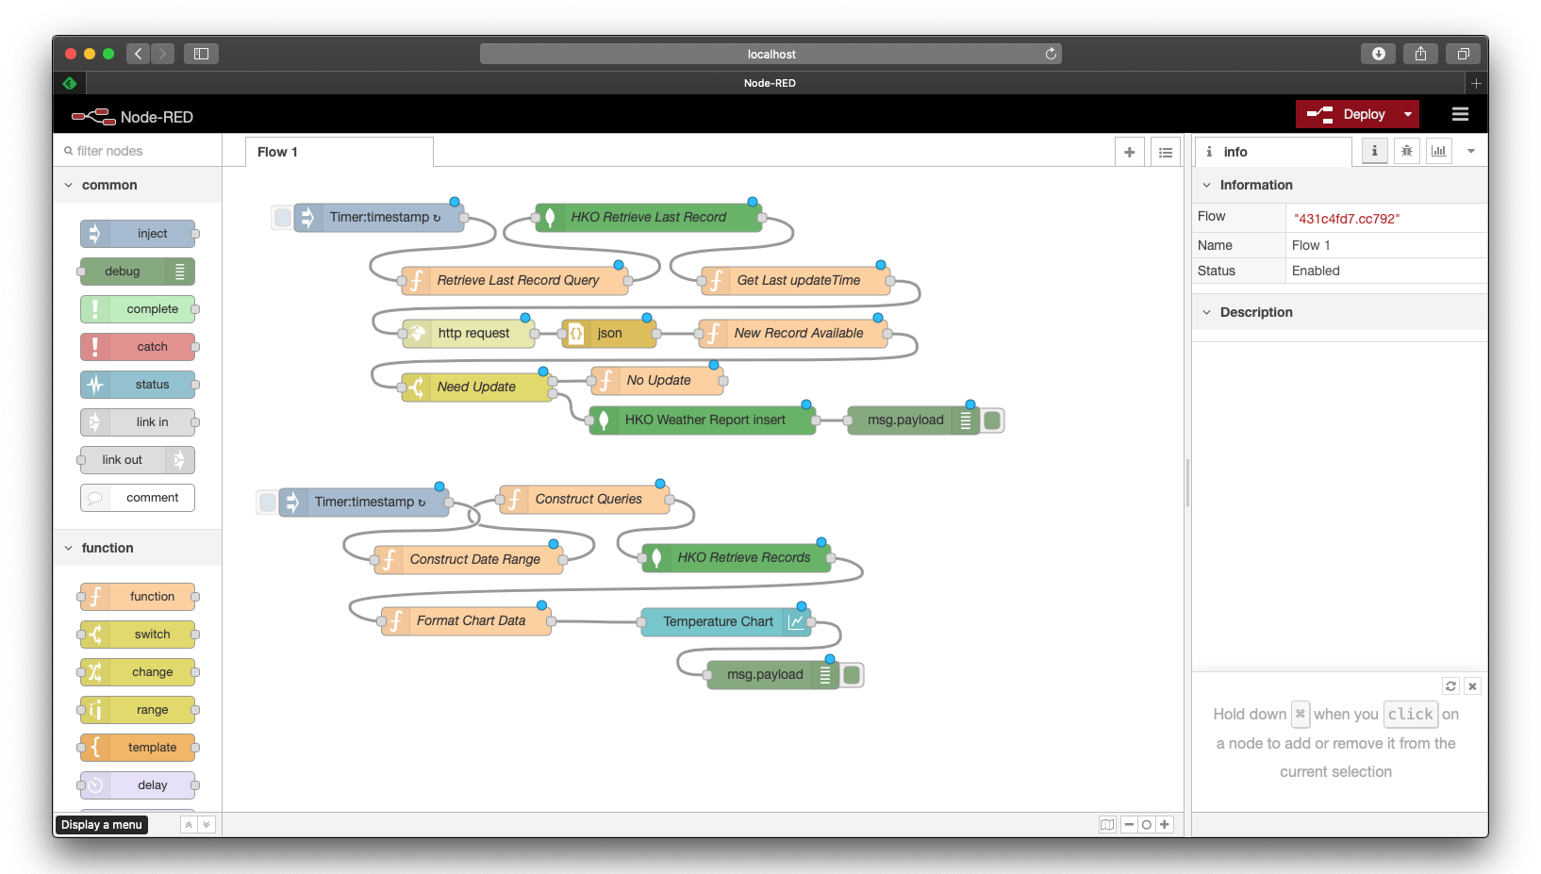
Node-Red Example Program
❖
After importing the flow, click Deploy button

Slide 21
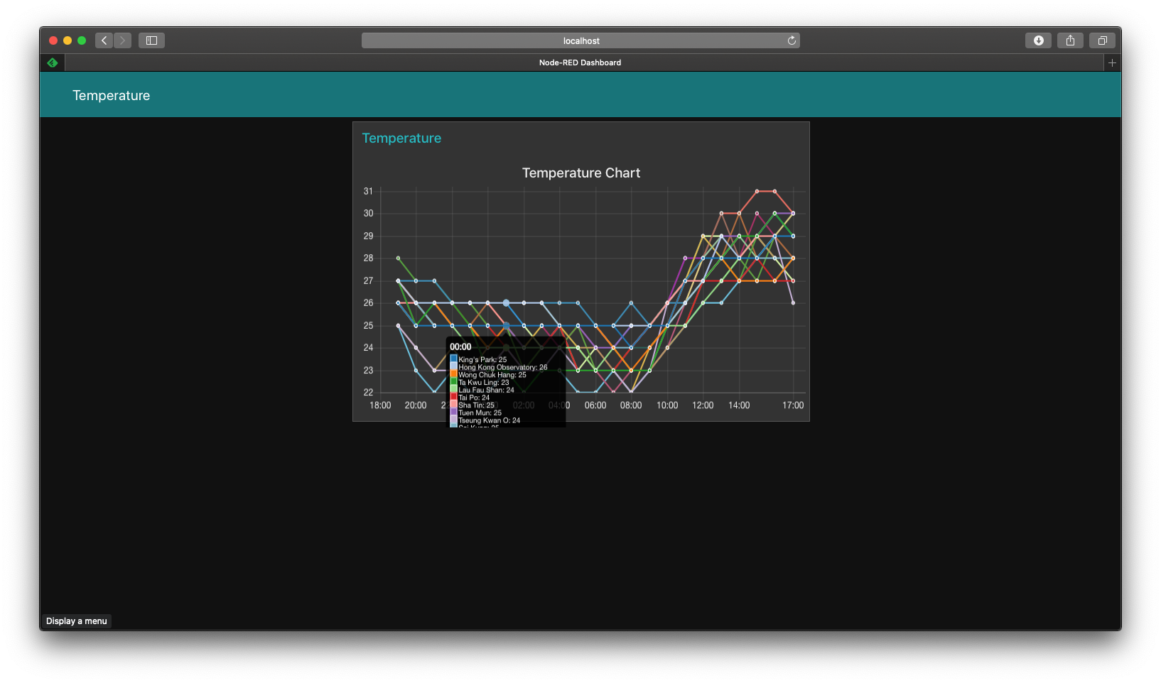
Node-Red Example Program
❖
After deployment, you can let the node-red instance to run for a couple of hours, and then launch another browser window and open the URL: http://localhost:1880/ui

Slide 22
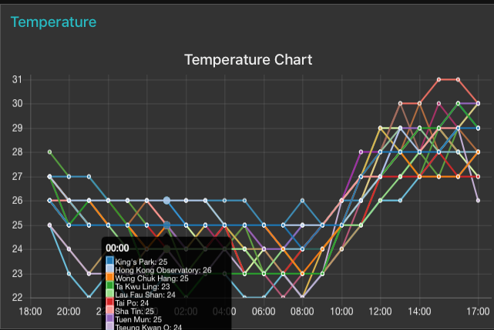
Node-Red Example Program
❖
You should see a chart, which plots the historical temperature of various Hong Kong locations up to the last 24 hours

Slide 23
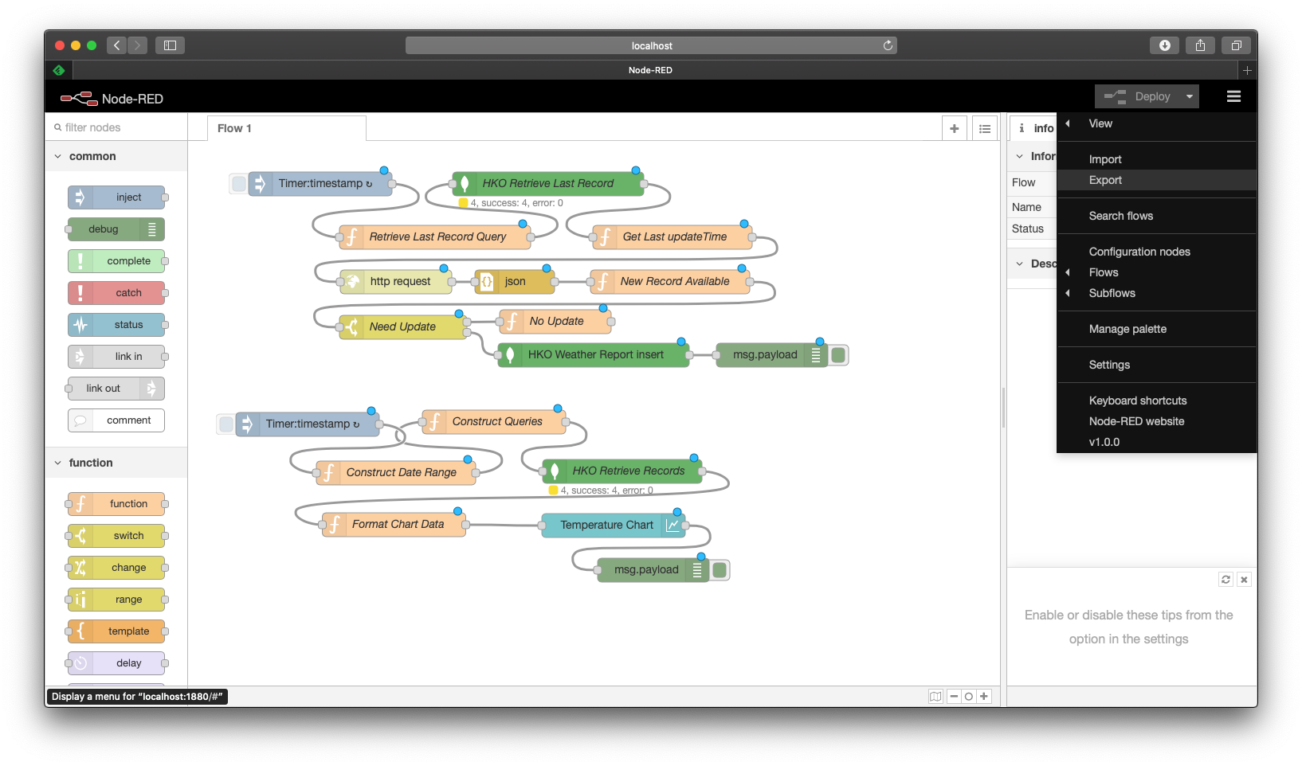
Exporting Node-Red Flow for Submission
Click the top right icon, and select Export
1
2

Slide 24
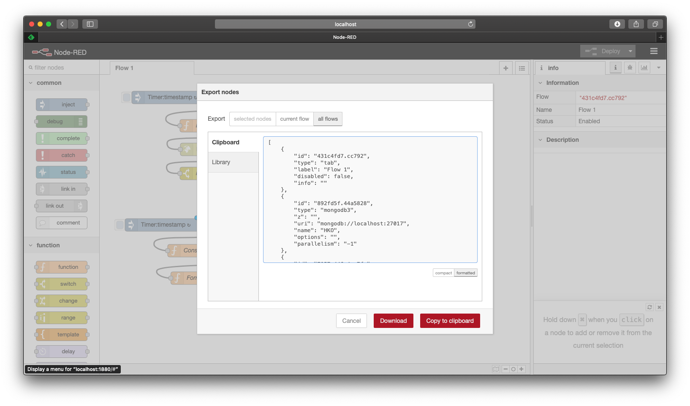
Exporting Node-Red Flow for Submission
Select all flows, formatted, and click Download button
1
2
3

Slide 25
Assignment Submission
❖
After completion of your assignment, you should export your flows in your node-red environment for submission in Moodle.
❖
You should also submit provide clear procedure to reproduce your development environment in Moodle as well, so that your tutor can access your docker instance for grading purpose.

